Slide 1
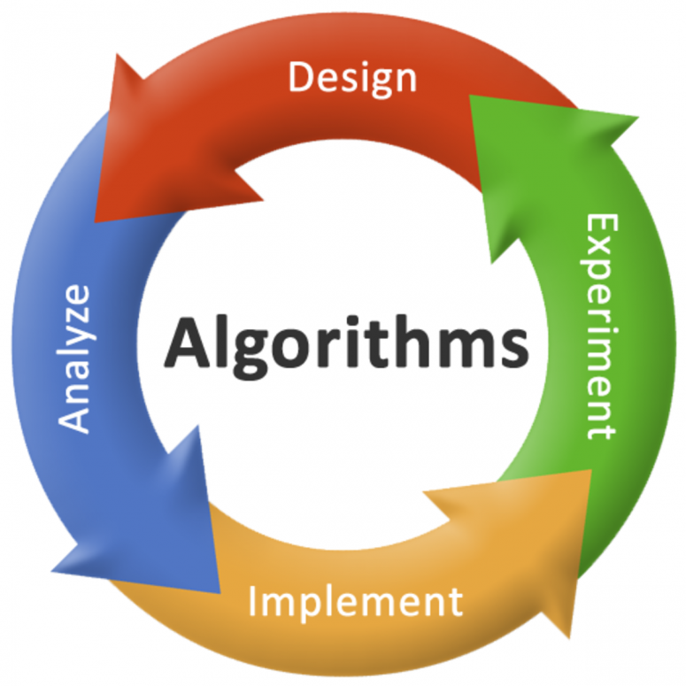
Introduction to Algorithms
Rachit adhvaryu

Slide 2
1.1.1 – Algorithms
An Algorithm is a well defined computational procedure that takes some set of instructions or set of values as an input in some specific sequence and generates output in finite amount of time.
Input
Computation
Output

Slide 3
1.1.2 – Algorithm Model
In short, An algorithm is a series of computational steps executed on some physical machine in proper sequence that transforms a given input to an output.
Problem to be solved
Algorithm :
Computational Procedures
RESULTS
INPUT
OUTPUT
System :
Physical Machine
ERRORS

Slide 4
1.1.3 – Properties of Algorithms
INPUT : set of Values required as an Input.
Output : must generate output either in form of Results or Errors.
Speed : an algorithm must be able to generate an output consuming less amount of time.
Definiteness : each Instructions in an algorithm must clearly specify its role.
Finiteness : an algorithm must terminate after finite number of steps.
Effectiveness : an algorithm must be human readable as well as it must provide a solution to a problem.

Slide 5
1.1.4 – Measures of Analysis
An algorithm can be analyzed or measured on the following parameters:
Space Complexity : amount of space occupied by an algorithm.
Time Complexity : amount of time taken by an algorithm for execution.
Input Size : number/values of inputs, an algorithm can handle effectively.
Order of Growth : effects on Time Complexity and Space Complexity on changing input size.
Computation of Best Case, Worst Case and Average Case : measures actually the performance of an algorithm

Slide 6
1.1.5 – Algorithm Design Techniques
An algorithm can be designed using following techniques:
Greedy Approach
Divide and Conquer
Dynamic Programming
Backtracking
Branch and Bound
Randomized Techniques

Slide 7
1.2 – Writing an Algorithm
An Algorithm can be written in 3 different ways:
using Flow Chart
using Natural Language
using Pseudo Code

Slide 8
1.2 – Writing an Algorithm – using Flow Chart
Flow Chart is a pictorial representation of a solution to a given problem. In short, it provides a diagram for the solution.
For e.g. – Flow Chart to Add 2 Numbers :
START
Input 2 numbers A & B
C = A + B
Print Sum = C
STOP

Slide 9
1.2 – Writing an Algorithm – using Natural Language
- use of English Language
- structure in form of steps
For e.g. Natural Language Algorithm to Add 2 Numbers can be described as :
Step 1: Take input of 2 numbers A & B
Step 2: Calculate C = A + B
Step 3: Print “Ans = “. C
Step 4: Stop

Slide 10
1.2 – Writing an Algorithm – using Pseudo Code
Pseudo Code is the best possible way to write an algorithm as it easy to read and understand.
Can be easily implemented in any programming language
Structure of Pseudo code is as follows:
Algorithm Heading
Pseudo Code Structure
Algorithm Body

Slide 11
1.2 – Writing an Algorithm – using Pseudo Code
Algorithm Heading Consists:
- Name of Algorithm : Define a name to an algorithm (Can be anything)
- Problem Description : Describe exactly what an algorithm will achieve
- Input : Describe what inputs that an algorithm will have to handle
- Output : Expected Output of an algorithm
Note:- All 4 components are compulsory to include in a Pseudo code
The syntax to write Algorithm Heading is as follows:
=> Procedure/Algorithm <Algorithm Name>(<Parameters>)
Keyword to define initiation of Algorithm. Write any 1
Name of Algorithm
Provide Parameters If any
// Problem Description:
// Input:
// Output:

Slide 12
1.2 – Writing an Algorithm – using Pseudo Code
Algorithm Body Consists:
actual statements of an algorithm
variable declaration and initialization
Input and output of variables
If – else statements
looping statements
all required components for an algorithm

Slide 13
1.2 – Writing an Algorithm – using Pseudo Code
Variable declaration and initialization
- No Datatypes required
- Declare a variable as per requirement
- To assign a value to the variable, “←” sign is used instead of “=“ sign
- For e.g. “A=5” can be written as “a ← 5”
Input and Output of variables
- “read” keyword is used for input
- “write” keyword is used for output
- For e.g. A ← 5, output of A can be written as write(A) OR write(“statement” . A)
- For e.g. To take input of variable A, the syntax will be read(A)

Slide 14
1.2 – Writing an Algorithm – using Pseudo Code
If – else statements
syntax is:
if (<condition>) then
statements
else
statements
endif
While Loop
syntax is:
while (<condition>) do
{
// body of while statement
}

Slide 15
1.2 – Writing an Algorithm – using Pseudo Code
Single For Loop
syntax is:
for <variable> ← Value1 to ValueN step <Value> (Optional – By Default { Increment by 1 // body of for loop if not defined)
}
Nested For Loop
syntax is:
for <variable1> ← Value1 to ValueN step <Value>
{
for <variable2> ← Value1 to ValueN step <Value>
{
}
}

Slide 16
1.2 – Writing an Algorithm – using Pseudo Code
For e.g. Write an algorithm to add 2 numbers
=>
Procedure/Algorithm Addition
// Problem Description: This algorithm will make addition of 2 numbers
// Input: 2 numbers A & B
// Output: Addition of 2 Numbers
C ← A + B
write(“Addition of 2 Numbers = “ . C)
Algorithm
Heading
Algorithm
Body
Last statement of algorithm indicates End of Algorithm

Slide 17
1.3 Mathematics in Algorithm

Slide 18
Simple Multiplication Methods
1. American approach
2. English approach
9 8 1
9 8 1
1
2
3
4
1
2
3
4
3 9 2 4
9 8 1
2 9 4 3
1 9 6 2
1 9 6 2
2 9 4 3
9 8 1
3 9 2 4
1 2 1 0 5 5 4
1 2 1 0 5 5 4

Slide 19
Simple Multiplication Methods
$3. à$ $la russe$multiplication
Write the multiplicand and multiplier side by side.
Make two columns, one under each operand.
Repeat step 4 and 5 until the number in the left column is 1.
Divide the number in the left hand column by 2, ignoring any fractions.
Double the number in the right hand column by adding it to itself.
Next cross out each row where the number in the left hand column is even.
Finally add up the numbers that remain in the right hand column.
981
1234
1234
490
2468
245
4936
4936
122
9872
61
19744
19744
30
39488
15
78976
78976
7
157952
157952
3
315904
315904
1
631808
631808
1210554

Slide 20
Set Theory
A set is an unordered collection of distinct objects.
The objects in a set are called elements or members of the set.
Example 1
$$Set A=\left\{1, 2, 3, 4\right\}$$
$$Set B=\left\{10, 20, 30, 40, 50\right\}$$
Roster Notation
Example 2
$$Set C= \left\{x \right|x is an even integer greater than 2\}$$
$$Set D=\{x | x∈C and x≤51\}$$
Set-builder Notation

Slide 21
Set Theory
Finite & Infinite sets: A set is finite if it contains a finite number of elements, otherwise it is an infinite set.
Examples:
$A = \left\{x\right|x∈Z and x^{2}−81=0\}$
$$A =\left\{−9,9\right\}$$
$N = \left\{x\right|x is divisible by 2\}$
Cardinality of set: The cardinality of a set denotes the number of elements in a set. The cardinality of a set $S$ is denoted by $n(S)$ or $|S|$.
Examples:
If $S$ is a set of English alphabets the $n(S) = |S| = 26$
The cardinality of an infinite set $X$ denoted as $\left|X\right|=∞$
The empty set denoted as $∅$ is the unique set whose cardinality is $0$.
Finite Set
Set $N$ is an infinite set

Slide 22
Set Theory
Subset: For two sets $A$ and $B$, we say that $B$ is a subset of $A$, written as $B⊆A$, if each member of set $B$ is also a member of set 𝐴.
Proper Subset: A proper subset of a set $A$ is a subset of $A$ that is not equal to $A.$
Example:
If $A=\{1,3,5\}$and $B = \left\{1,5\right\},$ set $B$ is a proper subset of $A$.
Set $C=\{1,3,5\}$is a subset of $A$, but it is not a proper subset of $A$ since $C=A$.
$$B\text{⊂}A$$
$$C⊆A$$
A
A=C
B

Slide 23
Set Theory
Power Set: Let $A$ be the set. The power set of $A$, written as $P(A)$, is the set of all subsets of $A$. It would be 2^{N} elements in a power set, where N is the total elements in a set.
Example:
$A= \{1, 2, 3\}$then the power set of $A is \{\left\{∅\right\}, \left\{1\right\}, \left\{2\right\}, \left\{3\right\},\left\{1,2\right\},\left\{2,3\right\},\left\{3,1\right\},\{1,2,3\}\}$

Slide 24
Set Theory
Complement: The complement of a set $A$ is the set $A’$ that contains every element of the Universal set U but not in A.
Example:
Consider $U = \{1,2,3,4,5,6,7,8,9\}$and $A = \left\{1,3,5,8\right\}$
Then $A′= \{2,4,6,7,9\}$
$$A′ = \{x | x ∈U and x∉A\}$$
A’
A
U

Slide 25
Set Operations
Union: The union of two different sets $A$ and $B$ is the set of all distinct elements of sets $A$ and $B$.
Example:
Consider $A = \{1,2,3,4,5\}$and $B = \{6,7,8,9\}$
Then $A ∪ B = \{1, 2, 3, 4, 5, 6,7, 8,9\}$
$$A ∪ B = \{x | x ∈ A or x ∈ B\}$$
A
B
A
B

Slide 26
Set Operations
Intersection: The intersection of two sets $A$ and $B$ is the set that contains all elements of $A$ that also belong to $B$ but no other elements.
Example:
Consider $A = \{1,2,3,4,5,6\}$and $B = \{2,3,6,8,9\}$
Then $A ∩ B = \{2,3,6\}$
$$A∩B = \{x | x ∈ A and x ∈ B\}$$
A
B

Slide 27
Set Operations
Set Difference: The set difference $A − B$of two sets $A$ and $B$ is the set of elements that are in $A$ but not in $B$.
Example:
Consider $A = \{1,2,3,4,5,6\}$and $B = \{2,3,5\}$
Then $A − B = \{1,4,6\}$
$A – B = \{x | x ∈ A and x ∉ B\}$
A
A
B

Slide 28
Set Operations
Symmetric Difference: The symmetric difference $A ⊖ B$ of two sets $A$ and $B$ is the set of elements that are in $A$ but not in $B$ and the elements that are in $B$ but not in $A$.
Example:
Consider, $A = \{1,2,3,4,5,6\}$and $B = \{1,3,5,7,9\}$
Then $A ⊖ B = \{2,4,6,7,9\}$
$$A ⊖ B = (A – B) ∪(B – A)$$
A
A
B
B

Slide 29
Set Operations
Sequences: A sequence of objects is a list of objects in some order.
Example: the sequence 3, 6, 18 would be written as (3, 6, 18)
In a set the order does not matter but in a sequence it does.
Repetition is not permitted in a set but repetition is permitted in a sequence. So, (3, 3, 6, 18) is different from (3, 6, 18).
Tuples: Finite sequences are called tuples.
Examples:
(3, 6) 2-tuple or pair
(3, 6, 18) 3-tuple
(3, 6,..., n ) n-tuple

Slide 30
Set Operations
Cartesian Product: The Cartesian product $A × B$ of two sets $A$ and $B$ is the set of all ordered pairs $(a, b)$where $a∈A$and $b∈B$.
Example:
$$A×B = \{(a, b) | a ∈ A and b ∈ B\}$$
$$(a,0)$$
$$(a,1)$$
$$A= \{a,b,c\}$$
$$(b,0)$$
$$(b,1)$$
$$B=\{0,1\}$$
$$(c,0)$$
$$(c,1)$$
$$A×B$$

Slide 31
Relation
Let $A$ and $B$ be two sets. Any subset $R$ of their Cartesian product $A×B$is a relation.
$$(a,0)$$
$$(a,1)$$
$$A= \{a,b,c\}$$
$$(b,0)$$
$$(b,1)$$
$$B=\{0,1\}$$
$$(c,0)$$
$$(c,1)$$
$$A×B$$

Slide 32
Properties of the Relation
Reflexive: Let $A$ be a set, and let $R$ be a relation on $A$. Relation $R$ is reflexive if,
Examples:
$∀a:[(a∈A)→((a, a)∈R)]$
Example 1
Example 2
$$A=\left\{1, 2\right\} and$$
$$R=\left\{\left(1,1\right), \left(1,2\right), \left(2,2\right)\right\}$$
$$A = \left\{4,5,6\right\} and$$
$$R=\{\left(4,4\right),\left(4,5\right),\left(5,5\right),(5,6)\}$$
Reflexive
Not Reflexive
since $(6,6) ∉ R$

Slide 33
Properties of the Relation
Symmetric: A relation $R$ on a set $A$ is called symmetric if $(a,b)∈R$then, $(b,a)∈R$, for every $a,b∈A$.
Examples:
Example 1
$$∀a:∀b:[((a,b)∈R)→((b,a)∈R)]$$
Asymmetric
(2,1),(3,2),(3,1) are not Present
$$A=\{1,2\} \text{and}$$
$$\text{So}\text{, }R=\{(1,2),(2,1)\}$$
Symmetric
Example 2
$A = \{ 1, 2, 3\}$and
So, $R = \{(1,1), (1,2), (1,3), (2,2),(2,3),(3,3)\}$

Slide 34
Properties of the Relation
Transitive: A relation 𝑅 on a set 𝐴, is called transitive if whenever (a,b)∈𝑅 and (b,c)∈𝑅, then (a,c)∈𝑅, for a, b, c∈𝐴.
Examples:
$$∀a:∀b:∀c[([(a,b)∈R]∧[(b,c)∈R])→(\left(a,c\right) ∈ R)]$$
Example 1
$$A=\left\{ 1, 2, 3\right\} and$$
$$R=\{(1,1), (1,2), (1,3), (2,2),(2,3),(3,3)\}$$
Transitive

Slide 35
Equivalence Relation
Equivalence Relation declares or shows some kind of equality or equivalence.
If the relation satisfies all three properties reflexive, symmetric and transitive then it is called an Equivalence Relation.
Equality ‘=’ relation is the equivalence relation because equality proves the required conditions.
Reflexive: $a=a$ is true for all values of $a$.
Symmetric: $a=b$ and $b=a$ is true for all values of $a$ and $b$.
Transitive: if $a=b$ and $b=c$ is true for all values then we can say that $a=c$.
For e.g. A = {a, b, c} and R = {(a,a),(a,b),(a,c),(b,b),(b,c),(c,c),(c,a),(b,a),(c,b)} is Equivalence Relation because it satisfies all the 3 properties.

Slide 36
Functions
Relationship between two sets of numbers is known as a function.
Function is a special kind of relation.
A number in one set is mapped to a number in another set by the function.
Example: A$Crocodile grows 5$cm every year, so the length of crocodile is related to its age using the function $l$:
$$l(age) = age×5$$
So, if the age is $8$ years,
then length is $l\left(10\right)=8 ×5=40$cm
$l(8)=40$is like saying 8 is related to 40.
Here, age is called Domain and length is called Codomain.

Slide 37
Function Notations
Domain: Values given as input to the function is called the domain of the function.
Codomain: Values that may possibly come out of a function is the codomain.
Range: Actual values that come out of a function is a range.
Example:
$$f:A→B, f(x)=3x+5$$
The range of the function $f\left(x\right)=\{8, 11, 14, 17\}$
$$8$$
11
14
17
$$1$$
$$2$$
$$3$$
$$4$$
Domain
Codomain

Slide 38
Relation & Function
is not a function as elements of domain refer to multiple elements of codomain.
is a function as elements of domain refer to only one element of codomain.
Relation 1
Relation 2
A
B
C
D
E
F
G
H
S1
S2
S3
A
B
C
D
S1
S2
S3
Division (Domain)
Students (Codomain)
Students (Domain)
Division (Codomain)

Slide 39
Vectors and Matrices
VECTORS
A vector is a list of numbers and is generally denoted by : $"u"$
If all the $u_{i}$ are zero, then $u$ is called the Zero vector.
If the number of components of two vectors $u$ & V and corresponding components
of both the vectors are same, then it is called Equal Vector.
Vector operations : Addition, Subtraction, Scalar Multiplication
$$u = (u_{1}, u_{2}, . . . , u_{n})$$
Where$u_{i}$are called the components of $u$.

Slide 40
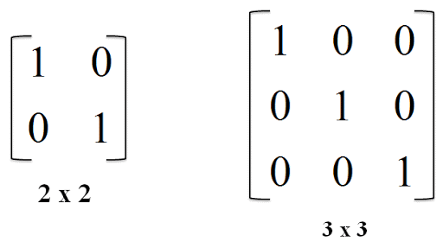
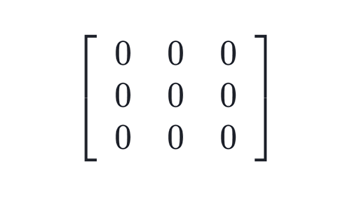
Vectors and Matrices
MATRIX
Matrix is a rectangular arrangement of array.
3x3 Matrix$: \left[\begin{matrix}1 & 2 & 3 \\ 4 & 5 & 6 \\ 7 & 8 & 9\end{matrix}\right]$
Matrix operations: Addition, Subtraction, Multiplication
Horizontally aligned elements are known as Rows
Vertically aligned elements are known as Columns
If all the elements of matrix are 0, then it is called Zero Matrix
If a matrix contain “1” as elements in its diagonal and rest all the elements are 0, then it is called Identity Matrix
<= ZERO Matrix
IDENTITY Matrix =>

Slide 41
Linear Inequalities
Inequalities: A statement that contains any of the <, >, ≤, ≥ symbols is known as Inequality.
Examples of inequalities are:
$a≥5$
$a +b +3c >26$
$x2+y2≤2$
$a+2b+6c<25$
Solutions to Linear Inequalities:
The solutions can be provided by assuming the required values for each variable.
In e.g. 1, substitute any value for “a” that is greater than or equal to 5
In e.g. 2, substitute a=4, b=5, c=6,
i.e. (4 + 5 + 18) = 27 > 26.
In e.g. 3, substitute x = y = 1,
i.e. (1² + 1²) = 2$≤$ 2
4. In e.g. 4, substitute a=1, b=2, c=3,
i.e. (1 + 4 + 18) = 23 < 25

Slide 42
Linear Equations
An equation that contains N number of unknowns is called Linear Equation
Linear equation with one Unknown
$$x=\frac{b}{a}$$
$$ax = b$$
Solution =>
$$x=\frac{12}{3}$$
For e.g.
3x = 12
Solution =>
=>
x = 4
Linear equation with Two Unknowns
$$ax + by =c$$
Solution =>
$$Assume any 1 unknown and find the other unknown$$
For e.g.
3x + 2y = 12
Solution =>
$$x=2$$
=>
6 + 2y = 12
=>
2y = 12 - 6
=>
2y = 6
=>
y = 6 / 2
Thus, x = 2 & y = 3

Slide 43
Linear Equations
Two Equations with Two Unknowns
A system of two linear equations in the two unknowns $x$ and $y$ is
$$a_{1}x + b_{1}y = c_{1}$$
$$a_{2}x + b_{2}y = c_{2}$$
The solution of above can be obtained using many different methods like Gauss Elimination, Gauss Seidel etc.

Slide 44
Logical Quantifiers
Quantifiers represent quantities. There are mainly 2 types of quantifiers:
1. Universal Quantifier: Any quantifier that starts with $“∀” i.e. \text{For} \text{Every}"$
Examples:
$∀x : P\left(x\right),$ x is an integer greater than 5.
In order to prove that a universal quantification is False, only one case is required to be False.
For e.g. $∀x : P\left(x\right),$ x is an integer greater than 5 => P(x) = {6, 8, 12, 15, 2}
Here, 2 is the case which makes the entire set to be False
In order to prove that a universal quantification is True, all the cases must be True.
For e.g. $∀x : P\left(x\right),$ x is an integer greater than 5 => P(x) = {6, 8, 12, 15, 25}
Here, there is no value that is less than or equal to 5. So all cases are True

Slide 45
Logical Quantifiers
2. Existential Quantifier: Any quantifier that starts with $“∃” i.e. \text{For} \text{Some}\text{ / }\text{For} \text{Few}"$
Examples:
$For P\left(x\right)= ∃x,$x is an integer greater than 5.
In order to prove that a existential quantification is False, all the cases is required to be False.
For e.g. $For P\left(x\right)= ∃x,$x is an integer greater than 5 => P(x) = {2, 5, 3, 4}
Here, all the cases make the entire set to be False.
In order to prove that a existential quantification is True, only one case must be True.
For e.g. $For P\left(x\right)= ∃x,$x is an integer greater than 5 => P(x) = {2, 5, 6, 3, 4}
Here, 6 make the entire set to be True.

Slide 46
Download the complete PPT from below link:
https://github.com/Follow-RachitAdhvaryu/Learning-is-Vital/tree/master/Algorithms/Chapter1
Like & Subscribe my YouTube Channel @:
https://www.youtube.com/channel/UC9vwz_9ydEfLoWPi6xjpXHQ?view_as=subscriber?sub_confirmation=1
Or
Search for “Learning is Vital” channel on YouTube

Slide 47
“ Happy Learning !...”
- Rachit adhvaryu

